Slide 1
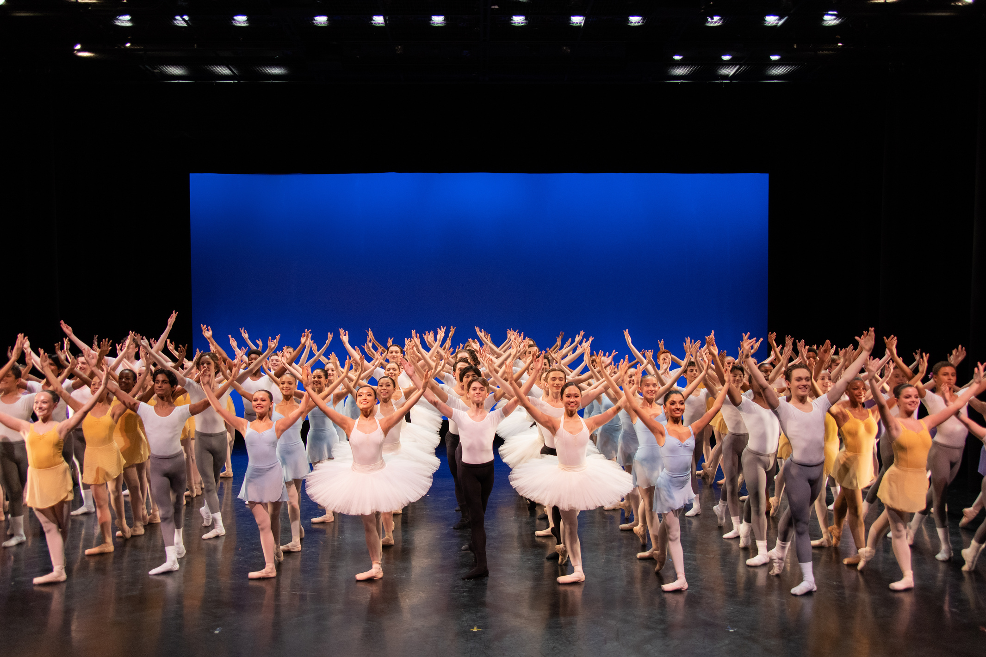

2027
5-Week Summer Intensive Program Handbook

Slide 2
03
Mission & IDEA Statements
04-06
Academy Staff & Faculty
07-08
Summer Calendar
09
Registration Information
10
Tuition, Housing, & Fees
11
International Student Information
12-13
Academy Procedures
14
Health and Wellness
15
Injury Policy
16-17
Optional Additions
18-20
Class Attire
21
Performances & Observations
22-26
Housing Information
27
Hurricane Evacuation Plan
TABLE OF CONTENTS

Slide 3
HOUSTON BALLET MISSION STATEMENT
To inspire a lasting love and appreciation for dance through artistic excellence, exciting performances, innovative choreography, and superb educational programs.
In furtherance of our mission, we are committed to maintaining and improving our status as:
  A classically trained company with a diverse repertory whose range includes the classics as well as contemporary works.
  A company that attracts the world's best dancers and choreographers and provides them with an environment where they can thrive and further develop this art form.
  An international company that is accessible to broad and growing local, national, and international audiences.
  A company with a world-class Academy that provides first rate instruction for dancers.
  A company that offers high-quality dance educational programming prioritizing historically underserved communities in Houston and the surrounding area.
  A company with state-of-the-art facilities for performances, rehearsals, and ongoing operations.
Inclusion, Diversity, Equity and Access Statement
Houston Ballet is dedicated to creating meaningful change by cultivating a space that honors what is unique in all of us. Inclusion, Diversity, Equity, and Access (IDEA) are instrumental in the fulfillment of our mission and values. We recognize our responsibility to be an inclusive and open organization for students, artists, staff, trustees, and volunteers of all backgrounds.
Join us, together we are Houston Ballet.

Slide 4










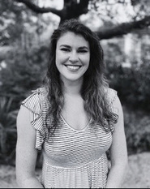

MEET THE ACADEMY
Stanton Welch
Artistic Director,
Member of the Order of Australia
Julie Kent
Artistic Director
Sonja Kostich
Executive Director
Jennifer Sommers
Academy Director
Katie Wesche
Academy Administrative Director
Beth Everitt
Associate Director of Programs and Performances
Yahudi Castañeda
Academy Artistic Operations Associate Director
Kaitlyn Louis
Associate Director
of Student Life
Carla Cortez
Academy Communications Manager
Jamie Cegelski
Academy Programs Manager
Reagan Quandt
Academy Artistic Operations Coordinator
Angela Flores
Academy Administrative Support Coordinator

Slide 5













ACADEMY ARTISTIC STAFF
Beth Everitt
Associate Director of Programs and Productions
Cheryne Busch
Upper School Principal
Claudio Munoz
HBII Ballet Master
Orlando Molina
Boys Program Coordinator
Betsy McMillan
Lower School Principal
Kelly Myernick
Principal Instructor
Susan Bryant
Principal Instructor
Christopher Coomer
Principal Instructor
Dalirys Valladares
Academy Instructor
GUEST ARTISTS BALLET INSTRUCTORS
Allison Miller
Lauren Anderson
Mallory Mehaffey
Naomi Glass
Yannik Boquín

Slide 6
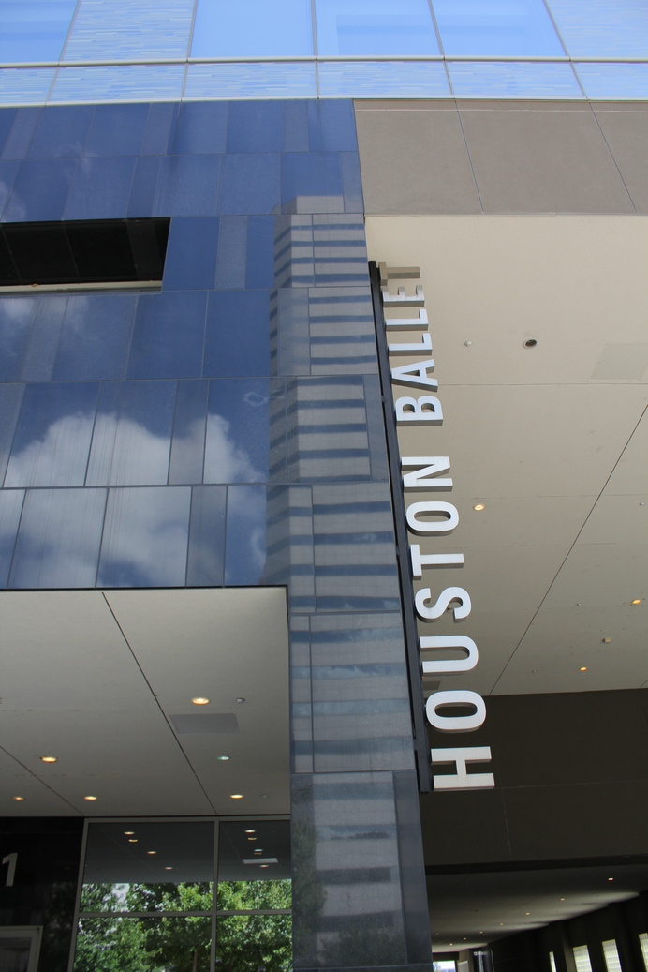
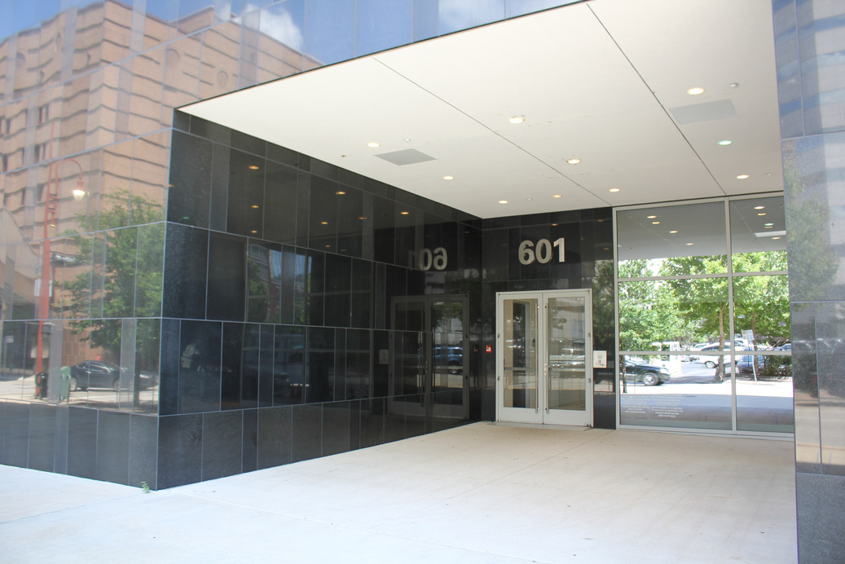

ACADEMY CONTACT INFORMATION
Summer Program classes are held at the Margaret Alkek Williams Center for Dance.
Margaret Alkek Williams Center for Dance Address:
601 Preston Street
Houston, TX 77002
Administrative Offices Phone Number:
713-523-6300
Academy General Inquiry Email Address:
hbacademy@houstonballet.org
Houston Ballet Summer Programs Website:
https://www.houstonballet.org/about/academy1/summer-intensive-program/

Slide 7

SUMMER CALENDAR
All dates and times are subject to change.
March | March | March | March | March | March | March
Sun | Mon | Tues | Wed | Thurs | Fri | Sat
7 | 8 | 9 | 10 | 11 | 12 | 13
14 | 15 | 16 | 17 | 18 | 19 | 20
 | Payment #1 DUE Deadline to withdraw with partial refund | Late Fee Added
April | April | April | April | April | April | April
Sun | Mon | Tues | Wed | Thurs | Fri | Sat
11 | 12 | 13 | 14 | 15 | 16 | 17
 |  |  |  | Payment #2 DUE | Late Fee Added
18 | 19 | 20 | 21 | 22 | 23 | 24
 |  |  |  |  |  | Health Profile due in one week!
25 | 26 | 27 | 28 | 29 | 30 | 1
 |  |  |  |  |  | Health Profile due today!
May | May | May | May | May | May | May
Sun | Mon | Tues | Wed | Thurs | Fri | Sat
2 | 3 | 4 | 5 | 6 | 7 | 8
Have you purchased your optional activities yet? The deadline is Friday, May 28th at 5:00 p.m. CST. | Have you purchased your optional activities yet? The deadline is Friday, May 28th at 5:00 p.m. CST. | Have you purchased your optional activities yet? The deadline is Friday, May 28th at 5:00 p.m. CST. | Have you purchased your optional activities yet? The deadline is Friday, May 28th at 5:00 p.m. CST. | Have you purchased your optional activities yet? The deadline is Friday, May 28th at 5:00 p.m. CST. | Have you purchased your optional activities yet? The deadline is Friday, May 28th at 5:00 p.m. CST. | Have you purchased your optional activities yet? The deadline is Friday, May 28th at 5:00 p.m. CST.
9 | 10 | 11 | 12 | 13 | 14 | 15
 |  |  |  |  |  | Payment #3 Due
16 | 17 | 18 | 19 | 20 | 21 | 22
 | Late Fee Added | Are you currently injured? Send us your 30-day clearance to dance paperwork today! | Are you currently injured? Send us your 30-day clearance to dance paperwork today! | Are you currently injured? Send us your 30-day clearance to dance paperwork today! | Are you currently injured? Send us your 30-day clearance to dance paperwork today! | Are you currently injured? Send us your 30-day clearance to dance paperwork today!
23 | 24 | 25 | 26 | 27 | 28 | 29
 |  |  |  |  | Optional Activities Deadline is today!

Slide 8
SUMMER CALENDAR
All dates and times are subject to change.
June | June | June | June | June | June | June
Sun | Mon | Tues | Wed | Thurs | Fri | Sat
30 | 31 | 1 | 2 | 3 | 4 | 5
Have you started packing yet? The packing list is on page 26! | Have you started packing yet? The packing list is on page 26! | Have you started packing yet? The packing list is on page 26! | Have you started packing yet? The packing list is on page 26! | Have you started packing yet? The packing list is on page 26! | Have you started packing yet? The packing list is on page 26! | Have you started packing yet? The packing list is on page 26!
6 | 7 | 8 | 9 | 10 | 11 | 12
13 | 14 | 15 | 16 | 17 | 18 | 19
 |  | Payment #4 DUE | Late Fee Added Airport Transportation Info Sent |  |  | Program & Dorm Check-In & Orientation
20 | 21 | 22 | 23 | 24 | 25 | 26
Weekend Activity #1 Swan Lake HB Performance | First Day of Classes |  | Audition Info Sesssion |  | Deadline to Purchase Catered Lunch
July | July | July | July | July | July | July
Sun | Mon | Tues | Wed | Thurs | Fri | Sat
27 | 28 | 29 | 30 | 1 | 2 | 3
Weekend Activity #2
4 | 5 | 6 | 7 | 8 | 9 | 10
Weekend Activity #3 |  |  |  | Deadline to Register for Audition
11 | 12 | 13 | 14 | 15 | 16 | 17
Weekend Activity #4 | Year-Round Audition | Year-Round Audition |  |  | Audition Results Distributed AFA Performance
18 | 19 | 20 | 21 | 22 | 23 | 24
Weekend Activity #5 | Class Observation Week (Schedule TBD) |  |  | Final Performance #1 & #2 | Last Day of Classes Final Performance #3 & #4 | Dorm Check-Out (No Classes)

Slide 9
REGISTRATION
Registration and payment are due by the deadline shown on the student's acceptance email to secure enrollment. Partial enrollment is not allowed.
Registration will close once level/section limits are reached.
Payment Methods
Houston Ballet accepts checks*, cashier's checks, cash, ACH+, or credit cards+. Payments may be mailed, hand-delivered, completed online, or phoned into the Academy office.
*If a check is returned for any reason, a $25 fee will be charged. The fee must be paid in cash within one week from the time the owner of the account is notified.
+ACH payments incur a processing fee of $1.50 per transaction. Credit card payments incur a processing fee of $2.75 per $99.99.
Scholarships & Financial Aid
Merit scholarships are awarded at the time of placement by the Academy Artistic Staff. Scholarships are based on the student's physical and artistic abilities. You cannot apply for a scholarship.
Financial aid is awarded via an application process. The application review process may take up to a month. Decisions are sent via email. Financial aid only covers a portion of costs and is typically no more than 25% of tuition. The application is available on the PowerSchool Parent Portal beginning January 1st.
Payments made by individuals or organizations on behalf of a Summer Intensive Program student are accepted but cannot be considered tax-deductible donations.
Withdrawal Policy
If a student wishes to withdraw from the Summer Intensive Program, a completed Withdrawal Form, available in your PowerSchool Parent Portal, must be received by the Academy Office. Verbal or email withdrawal notifications will not be accepted.
Refund Policy
All fees and 1/4 of tuition (and 1/4 of housing, if applicable) are non-refundable and non-transferable. The remaining tuition and housing fees are refundable before March 15, 2027. Formal withdrawal must be received by March 15, 2027, to be eligible for any refund. All fees, tuition, and housing are non-refundable and non-transferable after March 15, 2027. The Academy is not responsible or obligated in any way to process refunds or issue tuition credits after March 15, 2027.
It is recommended to purchase tuition insurance from a third party, such as
TravMark Activity Insurance.

Slide 10
TUITION, HOUSING, AND FEES
Registration Fee: $300
Health & Wellness Fee: $125
Tuition: $3,100
Housing Registration Fee: $300
University of St. Thomas (UST) Housing (optional): $3,400
Center for Dance (CFD) Housing (optional; available by artistic invitation only): $1,120
Market Square Tower (MST) Housing (optional; available by artistic invitation only): $1,120
*I-20 Processing Fee ($200) required for all international students.
**Optional additions are available at an additional cost.
Payment Schedule | Tuition Only | Tuition & UST | Tuition & CFD/MST
At the time of registration | $425.00 | $725.00 | $725.00
March 15, 2027 | 25% of tuition | 25% of tuition & housing | 25% of tuition & housing
April 15, 2027 | 25% of tuition | 25% of tuition & housing | 25% of tuition & housing
May 15, 2027 | 25% of tuition | 25% of tuition & housing | 25% of tuition & housing
June 15, 2027 | 25% of tuition | 25% of tuition & housing | 25% of tuition & housing

Slide 11

INTERNATIONAL STUDENTS
Non-United States citizens must obtain an I-20 and an M-1 visa to participate in the Summer Intensive Program. Canadian students only need to obtain an I-20 from the Houston Ballet Academy.
Steps to obtain the I-20 and M-1 visa:
  Please send the following information to the Associate Director of Student Life
    Copy of the biographical page of the student's passport
    Home address
    Home phone number
    U.S. Address while in Houston
  Receive a copy of the signed I-20 from the Associate Director of Student Life
  Print and sign the I-20
  Pay the I-901 SEVIS fee HERE
  Pay the I-20 Processing Fee in EduTrak no later than May 15th
  Schedule an appointment at your local U.S. consulate
  Receiving M-1 visa from the consulate
  Scan and email a copy of the M-1 visa to AcademyRecruiting@houstonballet.org.

Slide 12




PROCEDURES OF THE ACADEMY
Houston Ballet Academy Rules & Policies
The Houston Ballet Academy's rules and policies can be found HERE. We recommend reviewing this document in addition to the Summer Program Handbook. This document will include the Dance Center's general policies, appropriate student and employee participation, non-discrimination and non-harassment policy, anti-harassment policy, media and social media policies, health policies, and the releases included on the registration form.
Arrival & Departure
  Parking options are listed HERE.
  Families may use the driveway, entering from Congress Street.
  Commuting students use the leftmost lane.
  UST students use the far-right lane
  The center lane must be clear for passing vehicles.
Commuter Lane
Passing Flow Lane
UST Student Lane
  Driveway Policies
  It is recommended to arrive no earlier than the end of the student's last class.
  Do not drop off or pick up students on the roads next to the Center for Dance.
  Families are not allowed to park in the driveway.
  Do not walk up the ramps; use the sidewalks.
Always follow instructions provided by HPD officers, security guards, and class monitors at the Center for Dance and all City of Houston driving and parking regulations.
Leaving the Center for Dance during Breaks
Students may leave during class breaks in groups of three or more. A binder is available at the front desk for students to sign in and out.
Students living in off-campus housing within walking distance of CFD will be able to leave CFD on their own, but we recommend walking in groups.
Lunch
Students have the option to bring lunch, leave CFD in groups of at least 3 to purchase lunch off-site, or purchase the optional catered lunch ( Monday - Saturday only, sample menu below and purchasing details available on page 16).
Students will not have access to a refrigerator to store food but will have access to a microwave and vending machines.
Sample Catered Lunch Menu:
Monday | Tuesdays | Wednesday | Saturday | Thursday | Friday
Beef Enchiladas with Green Salsa Spanish Rice Black Beans/Charro Beans Roasted Brussel Sprouts & Corn Mushroom Tofu with Pasta and Black Beans | BBQ Pork Chops Mac & Cheese Roasted Corn on the Cob Cornbread Stuffed Eggplant with Bulgur Wheat | Creamy Steak Fettuccini Roasted Butternut Squash Garlic Bread Spinach Lasagna | Beef Guisada Yellow Rice Black Beans/Refried Beans Corn Tortillas Stuffed Acorn Wedges | Chicken Marinara Risotto Roasted Green Beans & Baby Carrots Garlic Bread Sticks Cauliflower Mac & Cheese | Swedish Meatballs Spaghetti Roasted Brussel Sprouts & Red Bell Peppers Dinner Rolls Potato & Mushroom Bake

Slide 13
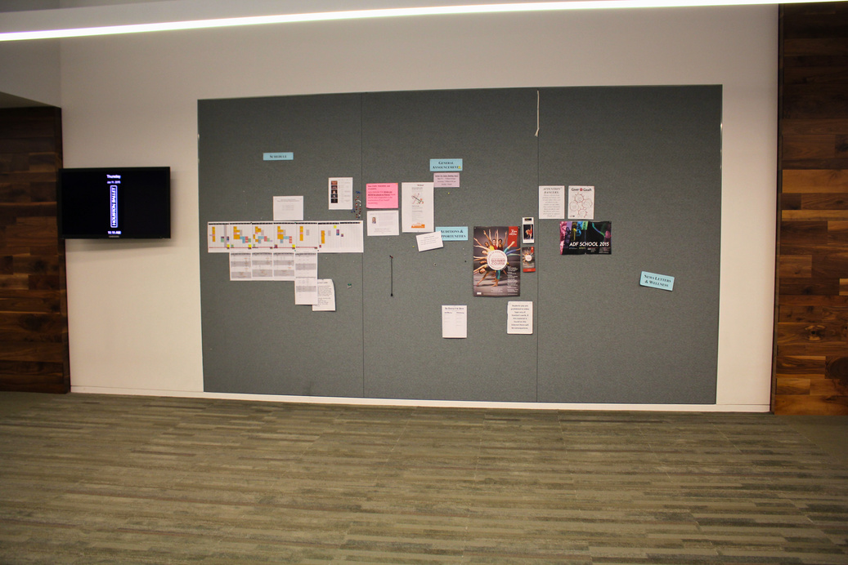
PROCEDURES OF THE ACADEMY
Attendance
  Attendance is mandatory in all classes.
  Partial attendance is not allowed.
  Weekly schedules are posted on the call boards and on the HB Academy Google site.
  If a student is absent, notify a chaperone (if applicable) and report their Absence using the PowerSchool School Messenger Application.
  If a student is injured and cannot participate in class, they must observe class/rehearsal and take notes.
If you become ill during the Summer Intensive Program:
  Notify an Academy staff member immediately
    If the student is at the Center for Dance, the parent/guardian or on-call chaperone will be notified to pick up the student for the remainder of the day.
  If a medical appointment is necessary and:
    The student resides in HB Housing, an Academy staff member will schedule an appointment, and the on-call chaperone will take the student to the doctor's office.
    If the student lives off campus, the parent/guardian will be responsible for scheduling and taking the student to the appointment.
  The student will be responsible for all costs, including co-pay, full payment in advance if required, and parking fees.
Evaluations & Private Lessons
There are no formal evaluations during the summer program. Private lessons and the use of private studios are not permitted during the summer program.
Letters & Packages for Students
Houston Ballet Academy is unable to receive any packages before the start of the summer program, and they can only be received during weeks 1 - 4 of the Summer Intensive Program.
Any packages received before the first day or during the last week of the Summer Intensive Program will be returned to the sender at the sender's expense.
Letters and packages should be mailed to the Academy office and addressed as follows:
Student First & Last Name + Summer Level
Houston Ballet Academy
601 Preston Street
Houston, TX 77002
Houston Ballet Academy will not be responsible for tracking lost mail or delivering packages to students. Mail remaining at the end of the program may only be forwarded to students if all fees have been paid.
Houston Ballet Academy Google Site
Students and parents/guardians will be able to access program information via the Houston Ballet Academy Google site. The link to this site will be available in the student’s registration confirmation email.

Slide 14
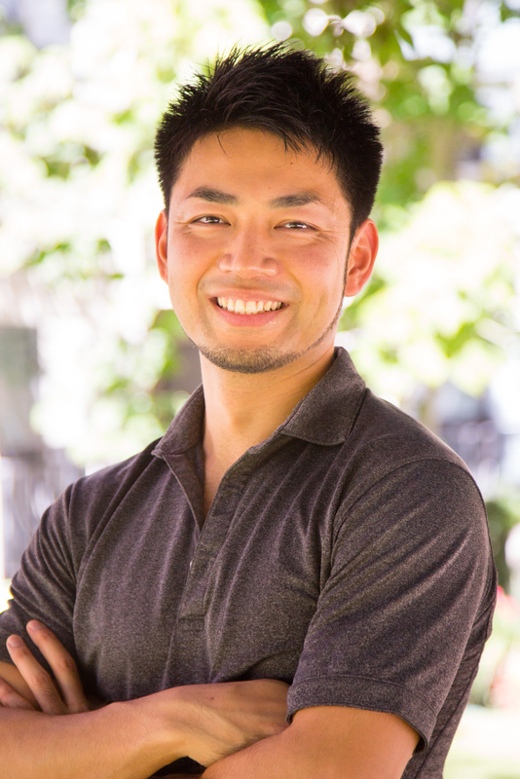
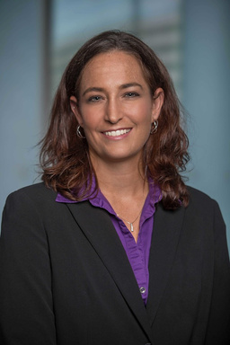
HEALTH AND WELLNESS
Aki Kawasaki
Head Strength and Conditioning Coach
Originally from Ibaraki, Japan, Akihiro Kawasaki holds a B.S. in Exercise Science from the University of Alabama at Birmingham. As a student athletic trainer, he worked with several sports teams, including the national championship-winning football team at Mississippi Gulf Coast Community College (MGCCC). Kawasaki previously served as a personal trainer and strength and conditioning coach for Olympians on Japan’s national team. He is currently the head strength and conditioning coach at Houston Ballet and Houston Ballet Academy. Kawasaki holds certifications in Functional Movement Systems (FMS) - Level 2, Y Balance Test (YBT) of FMA, Fundamental Capacity Screen (FCS) of FMS, Rossiter - Level 4, Yamuna Body Rolling - Face, Feet, Table Treatment, and Animal Flow and Spatial Medicine. Learn more at: https://bit.ly/3taRxwE.
OFFERINGS:
BODY CONDITIONING
WEIGHT TRAINING
YOGA
MAT CLASS
GYROKINESIS®
YAMUNA BODY ROLLING™
HEALTH & WELLNESS
PILATES
ATHLETIC TRAINER APPOINTMENTS
Dawn Stuckey
Certified Athletic Trainer
Dawn Stuckey is in her 6th season as an outreach athletic trainer at Houston Methodist Hospital and is in her 2nd year as the athletic trainer for the Houston Ballet Academy. She has worked as an athletic trainer for over 20 years, serving a multitude of sports and settings, and is also a current member of the Houston Rodeo Sports Medicine Committee, where she serves as an Assistant Captain.
Prior to Houston Methodist, Dawn Stuckey spent 13 seasons with Rice Athletics and most recently was one of the athletic trainers for swimming and women's Soccer.
Previously, Dawn Stuckey also served as an assistant athletic trainer for three years at Tyler Junior College in Tyler, Texas, working primarily with football, men's soccer, and women's basketball. Additionally, Stuckey served as an intern athletic trainer with the Houston Comets (WNBA) in 2005 and the Houston Rockets (NBA) in 2006 and 2007.
Dawn Stuckey graduated with her Doctorate in Athletic Training from A.T. Still University in 2023 and has been published in the Journal of Dance Medicine and Science. She earned her Master's degree in Health and Kinesiology from the University of Texas at Tyler in Tyler, Texas, in 2005 and minored in Athletic Training and Biology from Newman University in Wichita, Kansas, while working with a variety of sports teams including men's soccer, basketball, softball, and baseball. While attending Newman University, Dawn participated in varsity sports on the women's basketball team.

Slide 15
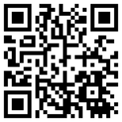
INJURY POLICY
Injuries and Illnesses
The Houston Ballet Academy employs fully trained instructors, and the utmost care is given to all students; however, the Academy is not responsible for any injury sustained by a student.
Any student who is not cleared to dance after 5 days of an injury will be sent home at the family's expense.
Cleared for dance at the Houston Ballet Academy is defined as:
  .Full participation in ballet technique class, including barre, center, turns, and small, medium, and large jumps.
  Full participation in all pointe classes if you wear pointe shoes, including barre, center, traveling, variations, and rehearsals.
  Full participation in contemporary, modern, jazz, and musical theater classes, including large jumps and floor work.
  Full participation in pas de deux at an age-appropriate level, including supported turns and lifts.
  Full participation in all rehearsals and performances.
If you have suffered an injury or undergone any procedure in the last six months:
  The student must receive full clearance for dance by a doctor at least three (3) weeks before the start of the program.
  A doctor’s note indicating full clearance for dance must be sent to our Houston Methodist Athletic Trainer, Dawn Stuckey, at dstuckey@houstonmethodist.org before the start of the program to ensure proper clearance to participate in the program.
  HBA strongly encourages the purchase of tuition insurance from a third party, such as TravMark Activity Insurance, to receive a refund in case the student must leave the program due to injury or illness.
If you are injured during the Summer Intensive Program:
  Notify an Academy staff member immediately
  The student will be evaluated by a Houston Methodist Athletic Trainer
  The Athletic Trainer will notify the parent/guardian and appropriate HBA staff of the student's evaluation.
  If a doctor's appointment is necessary, the Athletic Trainer will schedule an appointment.
    If the student resides in HB Housing, the on-call chaperone will take the student to the doctor's office.
    If the student lives off campus, the parent/guardian will be responsible for driving the student to the appointment.
    The student will be responsible for all costs, including co-pay, full payment in advance if required, and parking fees.
Injury Appointment Sign-Up:
Below is the information that you will need to sign up for appointments. You will use this to make appointments for the following: injury evaluations, rehabilitation, and treatment. These appointments are with the Houston Ballet athletic training staff.
  Scan the QR code with your phone.
  Select between an evaluation or treatment appointment slot.
  Select the correct date and time.
  Select “Continue as Guest”. Please be sure to fill in the form accordingly.
  In the ‘Comments’ section, be sure to put the following information:
    Your Student’s Level
    List what body parts you are being seen for.
  Select Confirm.
  Your appointment is now scheduled. You will receive an email notification.

Slide 16




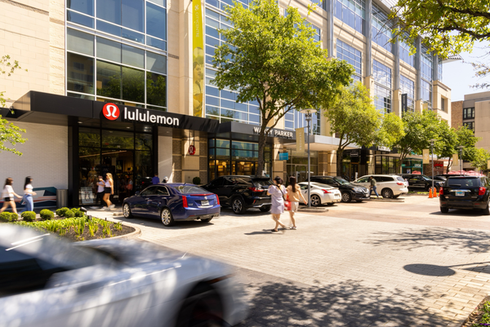
OPTIONAL ACTIVITIES
Optional activities are available to all students for an additional fee unless otherwise noted below. Fees for these options are non-refundable.
All students must travel with Houston Ballet Academy to and from all weekend activities (excluding Houston Ballet’s Performance of Giselle).
HOUSTON BALLET'S PERFORMANCE OF SWAN LAKE
$25
Enjoy an afternoon at the ballet. Following the performance, the students will get a backstage tour and ask questions to some company dancers.
If families wish to attend, tickets must be purchased at the box office (713-227-2787). Seating will be separate from student seating.
Deadline to register: 5/28
TYPHOON TEXAS WATER PARK
$60
Cool off from the Texas heat at Typhoon Texas! Stroll through the water park, relax in the Lazy T River, slide down one of the 33 water slides, and sample the amazing food.
Deadline to register: 5/28
HOUSTON ASTROS GAME
$60
Enjoy an old-fashioned pastime as the Houston Astros (two-time World Series Champions) take on the Tampa Bay Rays!
The price does not include food or drinks.
Deadline to register: 5/28
ANDRETTI INDOOR KARTING & GAMES
$80
Students will each get 1 go-kart race, 1 round of laser tag, 1 Hologate VR game experience, and 3 hours of unlimited arcade play time. Pizza lunch is included.
Deadline to register: 5/28
CITYCENTRE HOUSTON
$25
Enjoy a day of fun and shopping at CITYCENTRE Houston. This outdoor shopping center has stores for all price points, a bowling alley, a movie theater, and an escape room.
Deadline to register: 5/28

Slide 17
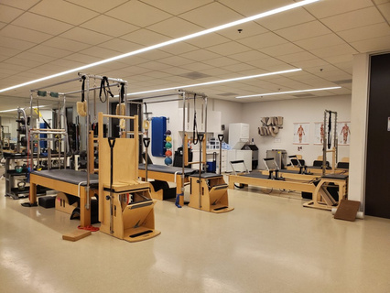



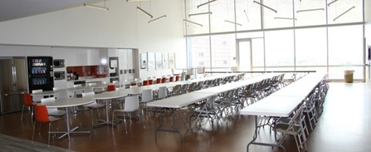
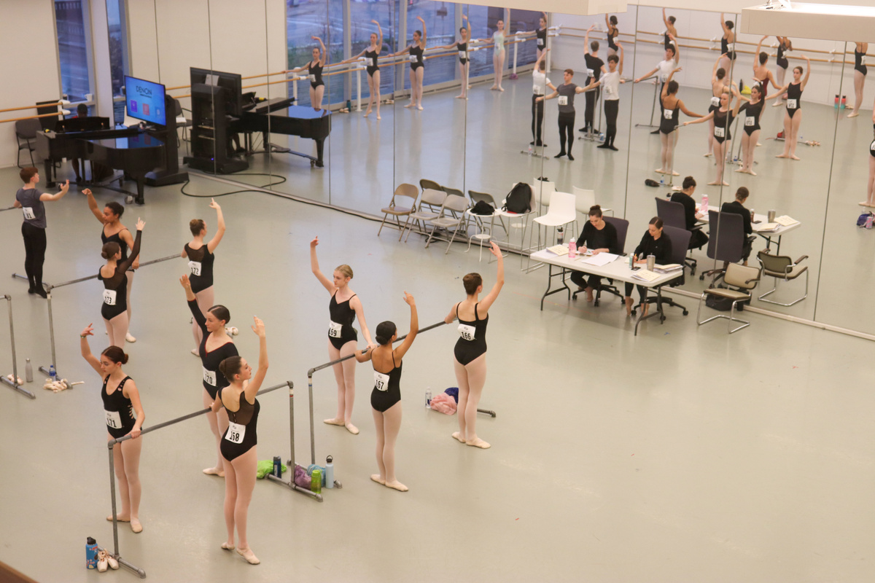
OPTIONAL ADDITIONS
All students may opt for optional add-ons for an additional cost, unless otherwise noted below. Fees for these options are non-refundable.
Semi-Private Pilates/Body Conditioning Sessions
$150 for 4 sessions
Available for students in Levels 6- 8 only.
Up to 3 students per instructor. Assignments are on a first-come, first-served basis. No refunds for unused sessions. Sessions expire at the end of the program.
Deadline to register: 5/28
AFA Choreographic Opportunity
Free
Available for students in Level 8 only.
Students work closely with young composers in the production of an original work.
Deadline to indicate interest: 5/28
An information session will be held on 6/14.
Airport Transportation
$35 each way
Available to UST and CFD residents only.
Transportation is provided by HB chaperones to and from George Bush Intercontinental Airport (IAH) or William P. Hobby Airport (HOU).
We cannot accommodate unaccompanied minors on official airlines.
Flights on 6/20 must arrive between 12:00PM and 4:00PM CT.
Flights on 7/25 must depart between 8:00AM and 2:00PM CT.
Deadline to register: 5/28
Catered Lunch
$450
Lunch provided Monday through Saturday of the first 4 weeks and Monday through Wednesday of the last week. Vegetarian option available. Other special dietary accommodations cannot be guaranteed.
Deadline for registration: 6/25
2026-2027 Audition
$50
Auditions are for the Pre-Professional Program & Professional Program. They are held during the fourth week of the program. Results are disseminated at the end of the day on July 17.
Deadline to register: 7/8
Info session will be held on 6/23.

Slide 18
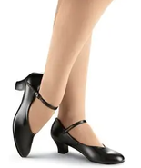

Click on links for more information and to order.
CLASS ATTIRE
Ballet Uniform
Level 5 | Level 6 | Level 7 | Level 8
Leotard: Wear Moi Galate style - Royal Blue | Leotard: Wear Moi Galate style - Black | Leotard: Wear Moi Galate style - Dark Grey | Leotard: Wear Moi Galate style - Light Grey
Tights: pink or skin tone-inclusive Shoes: pink or skin tone-inclusive | Tights: pink or skin tone-inclusive Shoes: pink or skin tone-inclusive | Tights: pink or skin tone-inclusive Shoes: pink or skin tone-inclusive | Tights: pink or skin tone-inclusive Shoes: pink or skin tone-inclusive
OR | OR | OR | OR
Shirt: Wear Moi Conrad style - White Tights: slate/grey Shoes: ballet slippers & tall socks - white | Shirt: Wear Moi Conrad style - White Tights: slate/grey Shoes: ballet slippers & tall socks - white | Shirt: Wear Moi Conrad style - White Tights: slate/grey Shoes: ballet slippers & tall socks - white | Shirt: Wear Moi Conrad style - Black Tights: black Shoes: Ballet slippers & tall socks - black
Belt: Discount Dance Supply style 62S - black (suggested) | Belt: Discount Dance Supply style 62S - black (suggested) | Belt: Discount Dance Supply style 62S - black (suggested) | Belt: Discount Dance Supply style 62S - black (suggested)
Pas de Deux Uniform
Ballet uniforms must be worn in Pas de Deux classes.
Students may wear black bike shorts over their uniform.
Modern/Contemporary Uniform
Leotard/Shirt: Ballet uniform
Tights: Ballet uniform or black
Shoes: Barefoot
Jazz Uniform
Leotard/Shirt: Ballet uniform
Pants: Black jazz pants or shorts
Shoes: Black jazz shoes
Character Uniform
Leotard/Shirt/Tights: Ballet uniform
Pants: Character Skirt
Shoes: Black Character Shoes
Shoes can be purchased through Dancewear Solutions
in Styles: Capezio 550 or B110

Slide 19
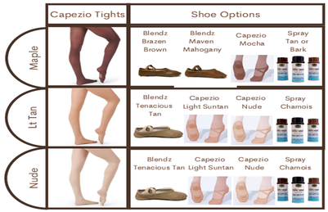
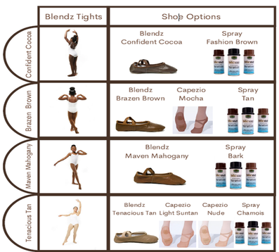
CLASS ATTIRE
Performance Requirements
Makeup & Hair: performance makeup (foundation, blush, eyeliner, mascara) & high-performance hair (bobby pins, hairnet, gel, clips, hairspray, bobby pins, etc.) Tights: Body Wrappers style A45 TPK convertible with seam - pink OR matching skin tone Camisole: flesh-colored Shoes: If pointe shoes are pink, 1 bottle of Kiwi Sport Whitener Shoe Polish - White & 1 bottle of CoverGirl Clean Make-Up - #105 Ivory If skin tone-inclusive pointe shoes, refer to the skin tone-inclusive recommendations below. | Makeup & Hair: performance makeup (foundation, blush, eyeliner, mascara) & high-performance hair (bobby pins, hairnet, gel, clips, hairspray, bobby pins, etc.) Tights: Body Wrappers style A45 TPK convertible with seam - pink OR matching skin tone Camisole: flesh-colored Shoes: If pointe shoes are pink, 1 bottle of Kiwi Sport Whitener Shoe Polish - White & 1 bottle of CoverGirl Clean Make-Up - #105 Ivory If skin tone-inclusive pointe shoes, refer to the skin tone-inclusive recommendations below. | Makeup & Hair: performance makeup (foundation, blush, eyeliner, mascara) & high-performance hair (bobby pins, hairnet, gel, clips, hairspray, bobby pins, etc.) Tights: Body Wrappers style A45 TPK convertible with seam - pink OR matching skin tone Camisole: flesh-colored Shoes: If pointe shoes are pink, 1 bottle of Kiwi Sport Whitener Shoe Polish - White & 1 bottle of CoverGirl Clean Make-Up - #105 Ivory If skin tone-inclusive pointe shoes, refer to the skin tone-inclusive recommendations below. | Makeup & Hair: performance makeup (foundation, blush, eyeliner, mascara) & high-performance hair (bobby pins, hairnet, gel, clips, hairspray, bobby pins, etc.) Tights: Body Wrappers style A45 TPK convertible with seam - pink OR matching skin tone Camisole: flesh-colored Shoes: If pointe shoes are pink, 1 bottle of Kiwi Sport Whitener Shoe Polish - White & 1 bottle of CoverGirl Clean Make-Up - #105 Ivory If skin tone-inclusive pointe shoes, refer to the skin tone-inclusive recommendations below. | Makeup & Hair: performance makeup (foundation, blush, eyeliner, mascara) & high-performance hair (bobby pins, hairnet, gel, clips, hairspray, bobby pins, etc.) Tights: Body Wrappers style A45 TPK convertible with seam - pink OR matching skin tone Camisole: flesh-colored Shoes: If pointe shoes are pink, 1 bottle of Kiwi Sport Whitener Shoe Polish - White & 1 bottle of CoverGirl Clean Make-Up - #105 Ivory If skin tone-inclusive pointe shoes, refer to the skin tone-inclusive recommendations below.
OR | OR | OR | OR | OR
Makeup & Hair: performance makeup (Foundation, Blush, Eyeliner) and performance hair (Hairspray, Gel) Tights: M. Stevens Convertible - Black Levels 7 & 8 males need to sew on skin toned elastic suspenders to their black tights Belt: Dance Jox - Beige Shoes: ballet slippers - Black & White | Makeup & Hair: performance makeup (Foundation, Blush, Eyeliner) and performance hair (Hairspray, Gel) Tights: M. Stevens Convertible - Black Levels 7 & 8 males need to sew on skin toned elastic suspenders to their black tights Belt: Dance Jox - Beige Shoes: ballet slippers - Black & White | Makeup & Hair: performance makeup (Foundation, Blush, Eyeliner) and performance hair (Hairspray, Gel) Tights: M. Stevens Convertible - Black Levels 7 & 8 males need to sew on skin toned elastic suspenders to their black tights Belt: Dance Jox - Beige Shoes: ballet slippers - Black & White | Makeup & Hair: performance makeup (Foundation, Blush, Eyeliner) and performance hair (Hairspray, Gel) Tights: M. Stevens Convertible - Black Levels 7 & 8 males need to sew on skin toned elastic suspenders to their black tights Belt: Dance Jox - Beige Shoes: ballet slippers - Black & White | Makeup & Hair: performance makeup (Foundation, Blush, Eyeliner) and performance hair (Hairspray, Gel) Tights: M. Stevens Convertible - Black Levels 7 & 8 males need to sew on skin toned elastic suspenders to their black tights Belt: Dance Jox - Beige Shoes: ballet slippers - Black & White
Skin Tone-Inclusive Shoes & Tights Matching Guide
Other Suggested Items
Mint foot spray or deodorizing wipes
Available at The Body Shop HERE or Amazon HERE
Saturday Free Dress
All students: leotard choice will be open, or t-shirt, leotard, or tank top choice is open; tights must be worn knee-length or longer.
Attire Procedures
Leg warmers and ballet skirts are not permitted in class.
Students may wear one pair of earrings. No other type of jewelry is permitted.
Tights must be worn as designed - no rolling at seams or hems.

Slide 20
CLASS ATTIRE
Uniform Purchases
Houston Ballet does not have a dance supply store on site. Students should arrive at the start of the program with all necessary attire, shoes, and accessories.
Uniform leotards and shirts can be purchased through our online site or in person at Dance Trends in Houston, Texas. Leotards and shirts purchased through our online site before May 15th will be shipped to the student, except for students with international addresses. Leotards and shirts purchased on or after May 15 will be held at the Center for Dance for pickup at check-in on Saturday, June 19, 2027.
If you need to process a uniform exchange or return, please get in touch with Leslie Goodrum at lgoodrum@houstonballet.org.
For additional supplies, including tights and shoes, items can be purchased through online stores or at the Houston-area dance store option listed below. We recommend calling any store before arriving to ensure they have the necessary items in stock.
Dance Trends 14520 Memorial Drive, Houston, TX 77079 (281) 558-1400
CFD Shoe Supply
Houston Ballet is privileged to have a supply of shoes on-site for the professional company. If a student is wearing the same brand and size as the surplus shoes in the shoe room, they may purchase shoes during the allotted hours, which will be available at the start of the program.
Custom shoe orders are not accepted for students. Requests to reserve shoes or inquire about the current supply of shoes prior to the start of the summer program will not be accommodated.

Slide 21
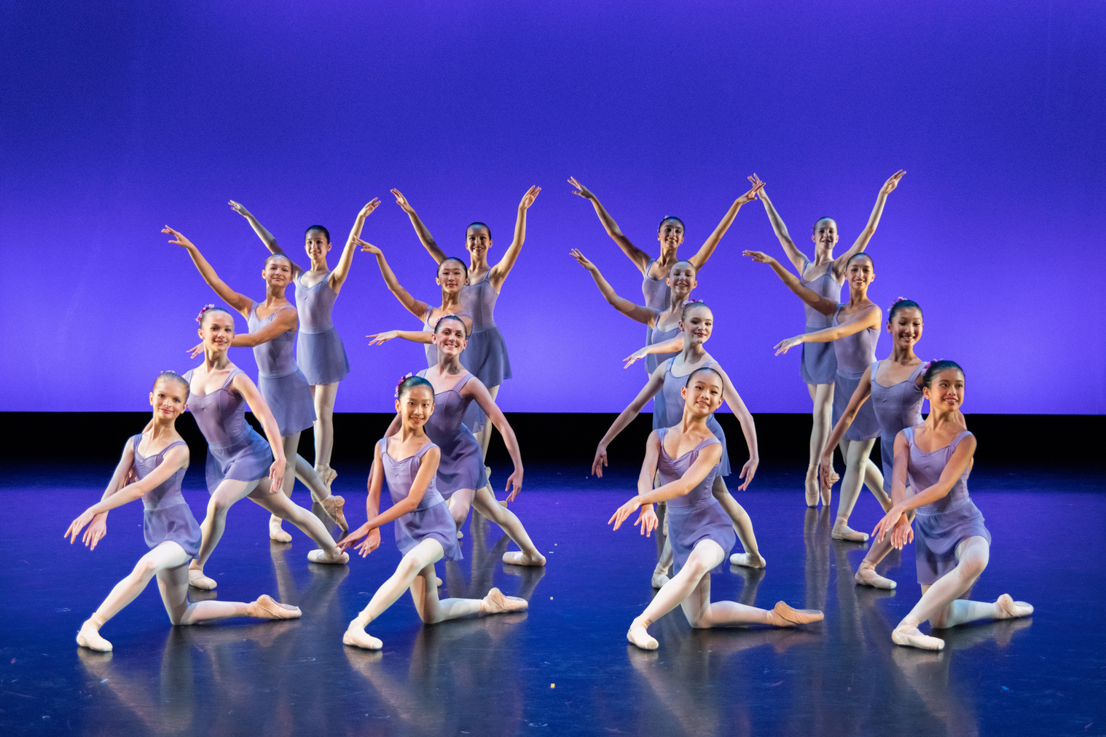
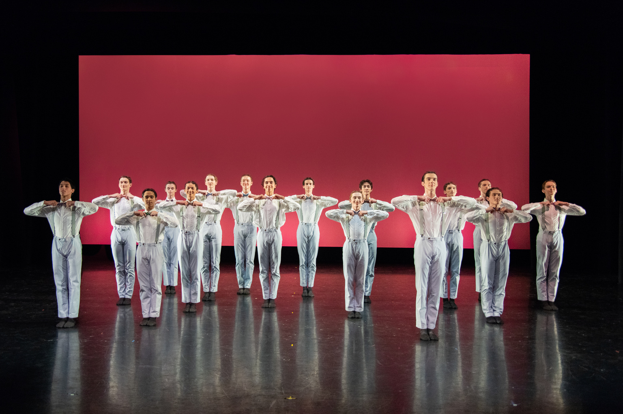
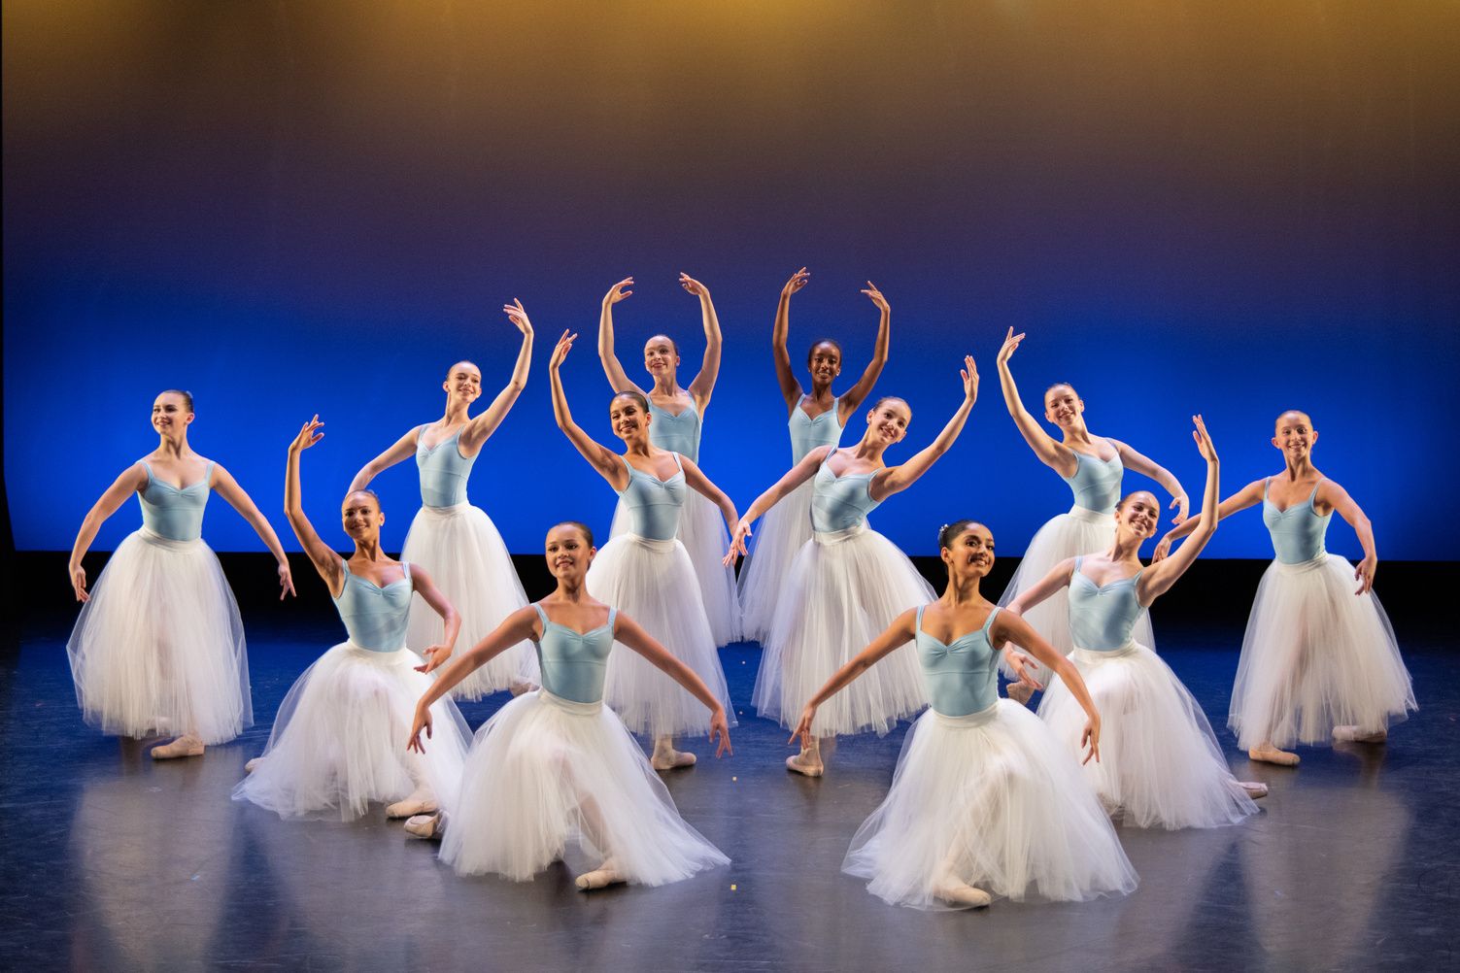
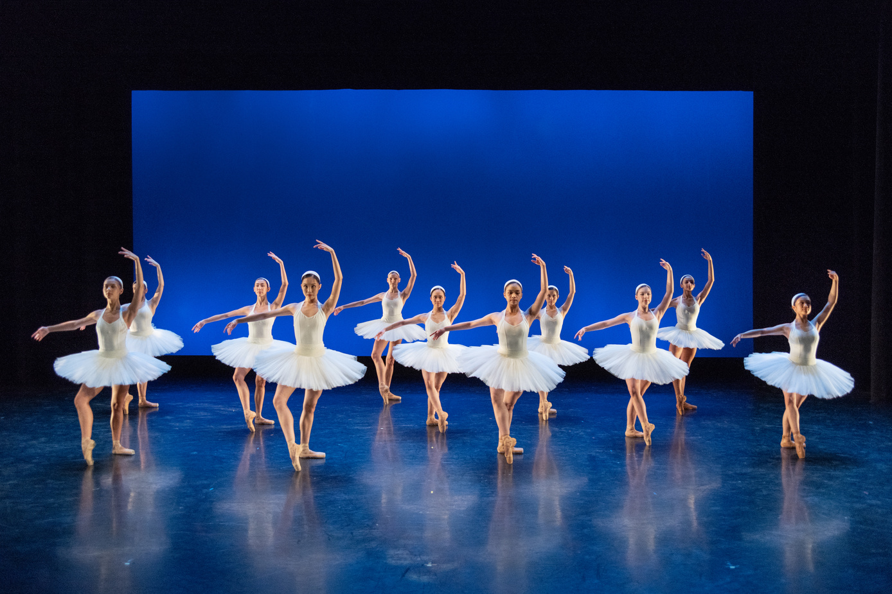
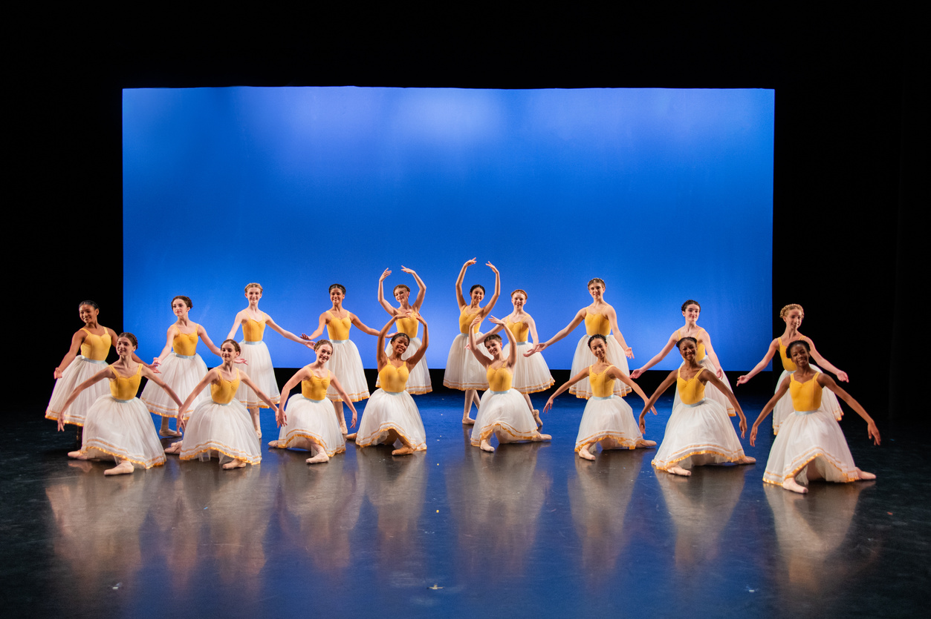
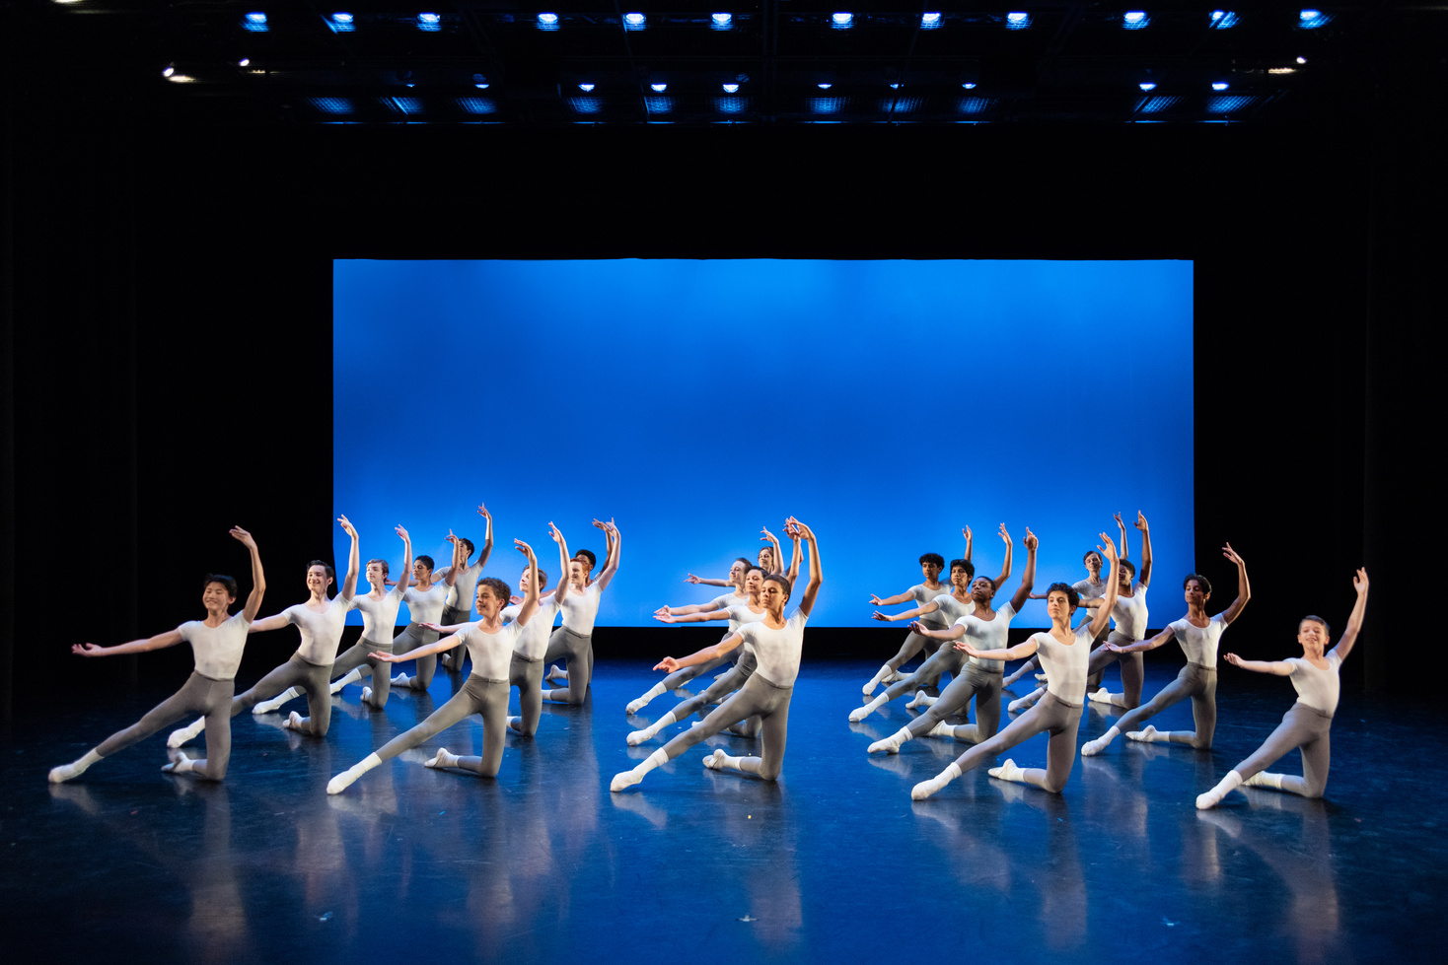
PERFORMANCES & OBSERVATIONS
Performance Information
  Families will receive an email notification at the end of the third week of the program with performance details. Casting will be posted on the Academy Google Site at that time.
  Families should not purchase tickets until the cast is announced. Because available seating is limited, we recommend that only immediate family members attend.
  Photography and video recording are not permitted during summer performances. Due to choreographic rights, we are unable to sell recordings of summer performances.
  Students are encouraged to watch the technical/dress rehearsal, as they will not be able to attend a performance without a ticket.
Tickets
  On sale: Monday, July 12th at 10:00AM CT
  Price: $15 per ticket
  How to Purchase: Call the Box Office at 713-227-2787 during business hours (Monday-Friday 9:00 a.m.-5:00PM CT)
  Tickets are general admission with no reserved seating.
  No refunds accepted. Exchanges are limited to casting changes.
  Tickets will be available for pickup on Thursday, July 22nd and Friday, July 23rd from 10:00AM CT until the start of each performance in the lobby of the Margaret Alkek Williams Dance Center.
Performance Location, Dates, & Times
  Location: Margaret Alkek Williams Dance Center, 601 Preston Street, Houston, TX 77002
  Dates & Times: Times are listed in Central Time. Dates and times are subject to change.
    Thursday, July 22nd 4:00PM & 7:00PM
    Friday, July 23rd 1:30PM & 4:00PM
  Viewing Options: In-Person & Livestream (links will be available on the Summer Google site)
Classroom Observations
  Classroom observations will take place during the last week of the summer program.
  Families will have the opportunity to observe their students' ballet technique class on a specific date.
  The observation schedule and details will be emailed at the end of the third week of the program.

Slide 22
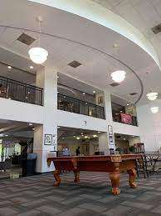
UNIVERSITY OF ST. THOMAS DORMITORY (UST)
Dorm Address:
University of St. Thomas
Guinan Hall
1303 Sul Ross Street
Houston, TX 77006
Qualifications:
  Students ages 12-17
    Minimum age = 12 as of 6/19/2026
    Maximum age = 17 as of 7/24/2026
  Priority will be given to students who live outside of
the Houston area.
  Partial stay in the dormitory is not allowed.
Costs:
$3400 + $300 housing registration fee
The cost includes:
  Breakfast and dinner daily, beginning with dinner on 6/19 and concluding with breakfast on 7/24.
    Provided at the UST cafeteria: UST & HB cannot guarantee special dietary accommodations.
  Dorm Room: Can be a double or triple room.
    2-3 beds, 2-3 dressers, 2-3 desks, MicroFridge in room with freezer and microwave, and cable TV connection.
  Dorm Hall Facilities: Please note that other programs also use these facilities
    Computer room, recreation room, movie room, and free laundry facilities.
  Wi-Fi is available in the lobby and rooms.
Check-In and Check-Out Dates:
  Check-In: 12:00 PM-4:00 PM on Saturday, June 19th
    If you are unable to check in by 4:00 PM, please email the Lead Chaperones.
  Mandatory Orientation: Sunday, June 20th
  Check-Out: 10:00 AM-9:00 PM on Friday, July 23rd or 7:30 AM- 12:00 PM on Saturday, July 24th
    We are not able to accommodate students in the UST dormitory after 12:00 PM on Saturday, July 24th.
  HB chaperones are no longer responsible for students who check out of the UST dormitory.
Roommate Assignments/Requests:
  Roommates can be requested but are not guaranteed. A form will open to all UST residents in March via the PowerSchool Parent Portal. Accommodations are only made if both parties request each other.
  Roommates are assigned by level and age as closely as possible.
  Requests to change roommates will only be accepted if all students involved agree to the change. The change can only be accepted if discussed with an HB chaperone.
  Students will never be placed in a single room. If a student's roommate leaves, that student will either be assigned another roommate or move into a room with two roommates.
  Houston Ballet reserves the right to place students in a double or triple room at any time.

Slide 23
UNIVERSITY OF ST. THOMAS DORMITORY (UST)
Transportation & Leaving the Dormitory:
  Students housed at UST will be transported to and from the Center for Dance for daily classes and weekend activities by buses provided by a third-party company or vans provided by chaperones.
  HB chaperones will schedule and transport students in vans to purchase food and other necessities during the program. This includes places such as Target and Kroger.
  Students may walk around campus in groups of 3 or more and may only go to approved areas during specified times.
  Students may be checked out by approved visitors. Parents/Guardians may complete the approved visitor form and email it to HB chaperones.
  Students must sign out and in with an HB chaperone before leaving the dormitory.
Dorm Expectations:
  Dorm rules will be addressed at the mandatory orientation on Sunday, June 21st.
  Students are responsible for maintaining a clean residence, including shared spaces.
    Students may be charged up to 90 days after the program end date for any damages incurred and reported by UST staff.
    Payment must be made within two (2) weeks of issuance.
  Student must be present when unpacking or packing belongings in the dorm room.
  At check-out, students will receive an orange ticket from an HB chaperone after the room has been inspected for cleanliness before check-out. Cleaning includes but is not limited to:
    Remove and place all trash from the room in the first-floor containers.
    Clean the Micro Fridge.
    Sweep the floor.
    Wipe and clean dressers, desks, sink, countertop, tub, and toilet.
    Remove decorations, tape, etc. from walls and doors.
    Remove all personal items from the dorm room and laundry room.
    Place unwanted items in donation boxes or in the trash.

Slide 24
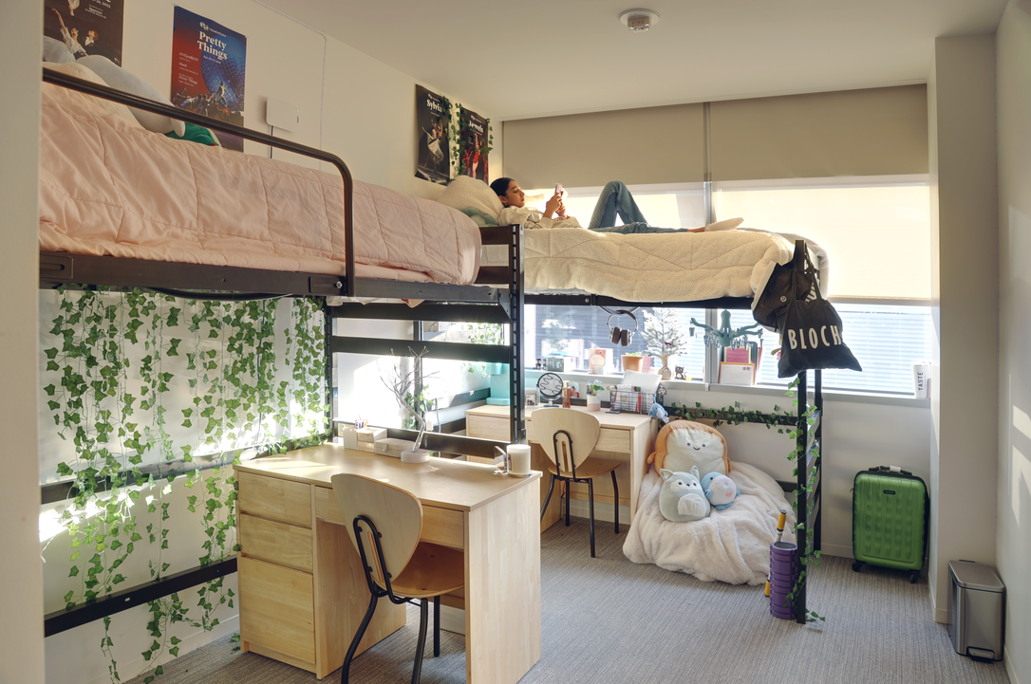
CENTER FOR DANCE DORMITORY (CFD)
Dorm Address:
Houston Ballet Center for Dance
601 Preston Street
Houston, TX 77002
Qualifications:
  By artistic staff invitation only
  Students ages 14-17
    Minimum age = 14 as of 6/19/2025
  Partial stay in the dormitory is not allowed.
  Costs:
  $1120 + $300 housing registration fee
The cost includes:
  2-3 community meals per week
  Shared dormitory - double occupancy rooms
    2 beds, 2 dressing tables, 2 desks
  Dorm Hall Facilities
    Full kitchen with assigned refrigerator & pantry areas, living/dining area with TV, free laundry facilities.
  Wi-Fi is available in all dormitory areas.
Check-in and check-out dates:
  Check-In: 12:00 PM-4:00 PM on Saturday, June 19th
    If you can’t check in before 4:00 PM, please email the Residential Life Coordinator.
  Mandatory Orientation: 8:00 PM on Saturday, June 19th
    Parents/Guardians are welcome to attend.
  Check-Out: 10:00 AM- 11:00 PM on Friday, July 23rd or 7:30 AM 12:00 PM on Saturday, July 24th
  HB chaperones are no longer responsible for students who check out of the CFD dorm.
Roommate Assignments/Requests:
  Roommates can be requested through the PowerSchool Parent Portal. A form will open to all CFD residents in March. Accommodations are only made if both parties request each other.
  Roommates are assigned by level and age as closely as possible.
  Requests to change roommates will only be accepted if all students involved agree to the change. The change can only be accepted if discussed with the Residential Life Coordinator.

Slide 25
CENTER FOR DANCE DORMITORY (CFD)
Transportation & Leaving the Dormitory:
  Students housed at CFD will be transported for weekend activities in vans by their chaperones or in buses by a third-party company.
  The Residential Life Coordinator will schedule and transport students in vans to purchase food and other necessities during the program. This includes places such as Target and Kroger.
  Students may leave the CFD in groups of 3 or more and may only go to approved areas during specified times.
  Students must sign out and in with the part-time chaperone before leaving the dorm.
Dorm Expectations:
  Dorm rules will be addressed at mandatory orientation on Sunday, June 20th.
  Students are responsible for keeping a clean residence, including shared spaces.
    Students may be charged up to 90 days after the program end date for any damages incurred and reported by the CFD staff.
    Payment must be made within two (2) weeks of issuance.
  Student must be present when unpacking or packing belongings in the dorm room.
  At check-out, students will receive confirmation from the Residential Life Coordinator or part-time chaperone after the room has been inspected for cleanliness before check-out. Cleaning includes but is not limited to:
    Remove and place all trash in the room.
    Clean out refrigerator and pantry areas.
    Sweep the floor
    Wipe and clean dressers, desks, sink, countertop, tub and toilet.
    Remove decorations, tape, etc. from walls and doors.
    Remove all personal items from the dorm room and laundry room.
    Place unwanted items in donation boxes or in the trash.

Slide 26
ADDITIONAL HOUSING INFORMATION
Suggested Packing List:
  Bedding & Pillows
    Twin XL sheets are required for UST residents
    Twin sheets are required for CFD residents
  Towels
    Bath towel, hand towel, washcloth, and beach towel.
  Toiletries
    Shampoo, soap, deodorant, sunscreen, toothbrush, and toothpaste.
  Bathroom Necessities
    Toilet paper, hand soap, and trash bags.
  Dance Attire & Shoes
  Non-Dance Clothing & Shoes
    Including but not limited to dress clothes for Houston Ballet performance, warm-up gear, lightweight jacket, swimsuit, T-shirts, shorts, sneakers, flip-flops, slippers, hat, and sunglasses.
    Please note that crop tops and short shorts are not permitted at the UST dormitory.
  Hangers
  Umbrella/Rainwear
  Reusable Water Bottle
  Alarm Clock
  Extension Cords
  Laundry Bag & Detergent
  Phone Chargers
  Electronics
    Including but not limited to cameras, cell phones, computers, and tablets.
Head Lice Prevention:
We encourage all students to get checked for head lice prior to check-in at the dorm to avoid potential problems. A licensed medical professional or lice treatment center can perform this test.
Any student found to have head lice after arrival will be quarantined and receive professional treatment at the expense of the parent/guardian. The student will not be allowed to return to class until fully treated.
Packages:
Houston Ballet Academy recommends students pre-order supplies and have them available for pickup at the following Target location:
Target
2075 Westheimer Road
Houston, TX 77098
Phone Number: 346-398-5902
Families should refer to the information on page 13 regarding sending letters and packages during the program.

Slide 27
HURRICANE EVACUATION PLAN
Hurricane season begins June 1st and ends November 30th. The Houston Ballet Hurricane Evacuation Plan (HEP) is implemented if a hurricane evacuation has been issued for Harris County.
Qualifications:
  Students residing in HB housing (UST, MST, CFD)
  Students residing off-campus without a family member
  Students, who meet one of the two requirements above must opt ​​for the HEP at the time of registration.
Shelter:
  A safe shelter as identified by the American Red Cross
  Food, water, and first aid supplies will be provided.
  Transportation and chaperone supervision will be provided.
Steps Taken at the Time of Issuance:
  Message sent to all families and students that an evacuation has been issued and the HEP has taken effect.
    Those who have not opted into the HEP should prepare their plans and check-out with their chaperone or an Academy staff member.
    Staff will have an emergency telephone with information included in the message.
  Students will return to their residences and pack necessary belongings.
    One (1) duffel bag or regular-sized piece of luggage, blanket, pillow, important documents, and prescription medication.
  Students will gather at the UST dormitory to be transported to the shelter.
    Transportation to any other location will not be provided for students.
  Updates will be sent regularly to families and students.
  Once it is declared safe to return, students will be transported back to the UST dormitory.
  Notifications will be sent to families and students.
Please note that students who do not opt ​​into the HEP will be responsible for coordinating their alternative hurricane evacuation plans.

